Slide 1


Slide 2

Nirvana
Notes:
Why the chiropractic lifestyle is a healthy family’s - secret winning formula.

Slide 3

1186
# of live births in Spain per day
433,836 live births in 2021
2,371
# of live births in the UK per day
681,560 live births in 2020
Notes:
We lack the SKILLS and the CONFIDENCE
What holds us back …………from ACCESSING THOSE 3013 babies each day
AND having mothers being raving fans and referring in hundreds of other mothers is our own BS
that's right – our own Belief System
Sometimes we think everyone else has the answers, everyone else has the skills. WE might think. “were too young
Too male
Or we don’t have children, NOT ENOUGH EVIDENCE to support chirop
that we are in the wrong area,
we are surrounded by too many chiropractors etc, etc,” WE CAN HAVE OUR OWN PITY PARTY
All of these ARE EXCUSES regarding – our Capacity and our Brilliance.
Fears dresses us up and makes us a victim of the world.
I have been around thousands of chiropractors my whole life, Simon and I have had 20 plus associates
Let me share this with you
That IT MATTERS LITTLE
IF YOU HAVE BEEN IN PRACTICE
6 MTHS,
6 YEARS,
6 DECADES
– or if you have 1 child or 10
WHAT matters most is to your client
is that you deliver superior service beyond their expectations
AND that they develop
an UNSHAKEABLE BELIEF in YOUR CAPACITY to help them

Slide 4
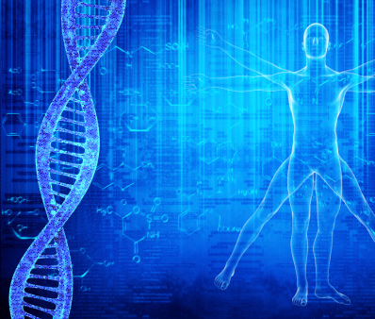
“The master maker of the human body did not create you and then run off and leave you masterless.
He stayed on the job as innate, as the fellow within, as nerve transmission controlling every function of life, as spirit from above-down, inside-out, expressing, creating, exploring, directing you in every field and phase of experience so that your home is truly the world, and the world is your home.”
BJ Palmer.

Slide 5
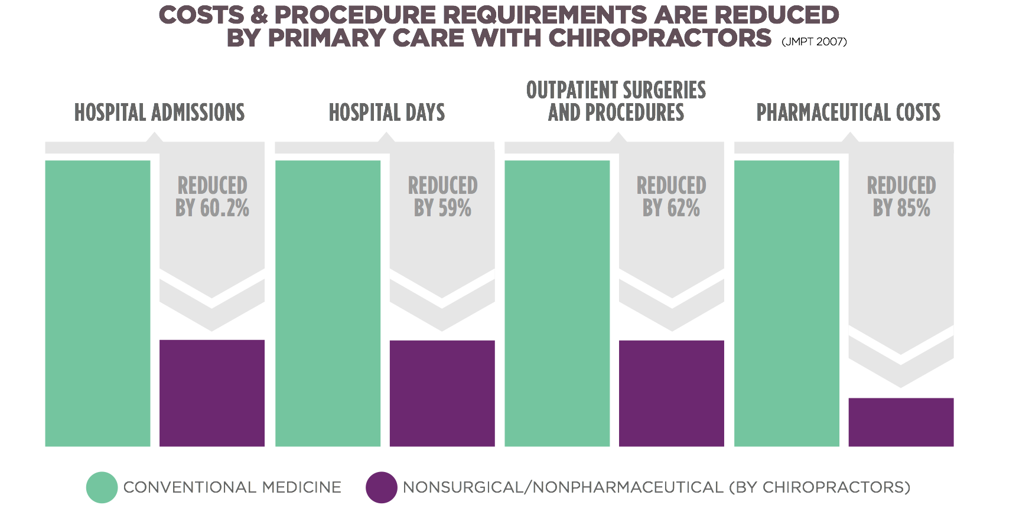
A seven-year study compared the clinical and cost utilisation of nonsurgical/ nonpharmaceutical care given by primary care physicians (PCP) who were mostly chiropractors, as compared with PCPs using conventional medicine alone.
Sarnat RL et al. Journal of Manipulative and Physiological Therapeutics (JMPT). 2007
Notes:
Benefits of Long term Chiropractic care - A seven-year study from the US published in the esteemed Journal of Manipulative and Physiological Therapeutics (JMPT), compared the clinical and cost utilisation of nonsurgical/ nonpharmaceutical care given by primary care physicians (PCPs) who were mostly chiropractors, as compared with PCPs using conventional medicine alone. For the PCPs who were chiropractors, this study demonstrated:
• reductions in hospital admissions by 60.2%
• reductions in hospital days by 59.0%
• reductions in outpatient surgeries and procedures by 62.0%
• reductions in pharmaceutical costs by 85%
Sarnat RL, Winterstein J, Cambron JA. Clinical Utilization Cost Outcomes From an Integrative Medicine Independent Physician Association: An Additional 3-Year Update. Journal of Manipulative and Physiological Therapeutics JMPT May 2007; 30(4):263-269

Slide 6
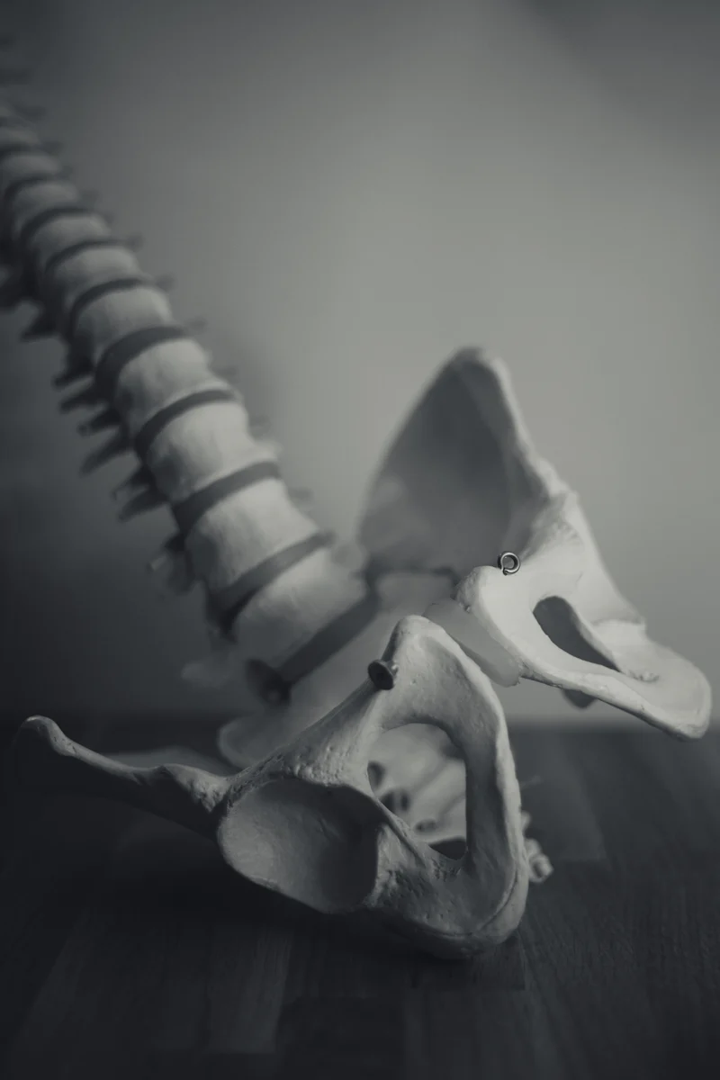
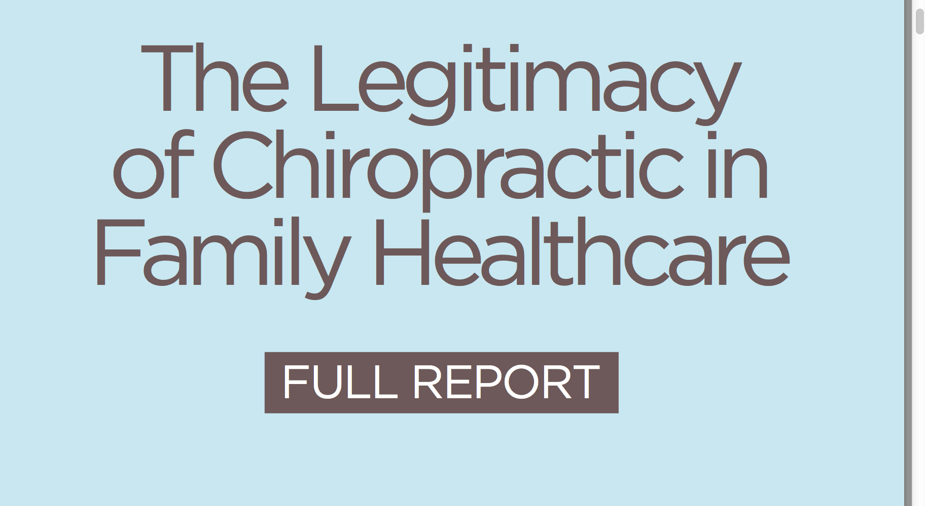

Slide 7
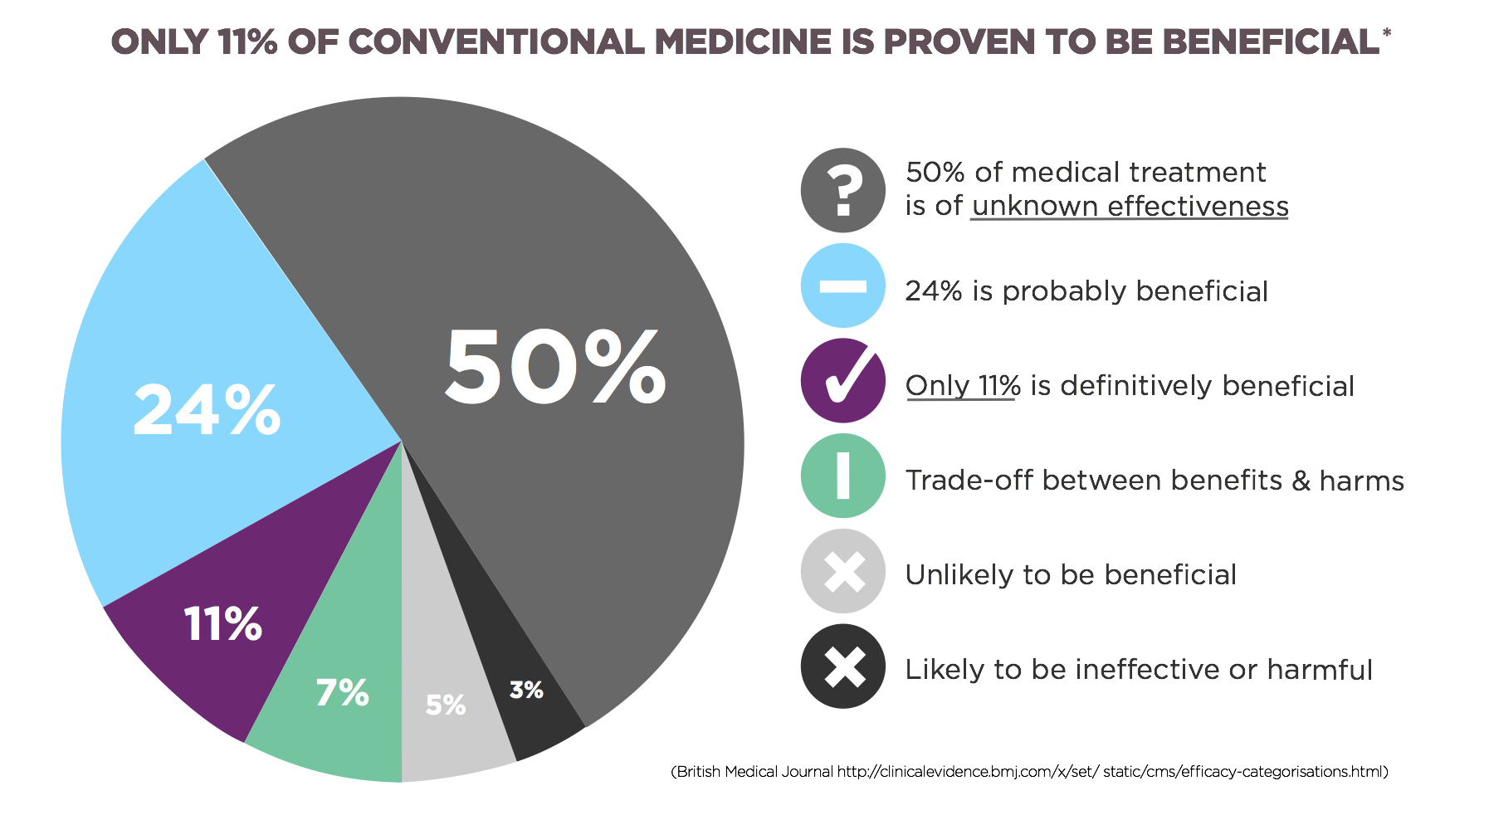
Notes:
Even with all their research
People are Questioning their effectiveness

Slide 8
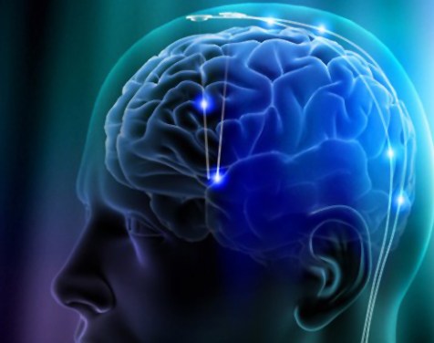
Recorded changes in brain function, post adjustments in :
sensory processing at the primary sensory cortex
sensory motor integration at the primary sensory cortex
at the primary motor cortex
in circuits involving the basal ganglia and prefrontal cortex
in intramuscular inhibitory drive to muscles from the brain
intra cortical facilitatory drive to muscles from the brain
the way the brain filters proprioceptive afferent information
in motor control- increased cortical drive to the muscle
presynaptic inhibition of one A afferent synapses
the central nervous system is better able to use muscle spindle information, and more efficiently produce force
forward activation of trunk muscles when raising an arm

Slide 9
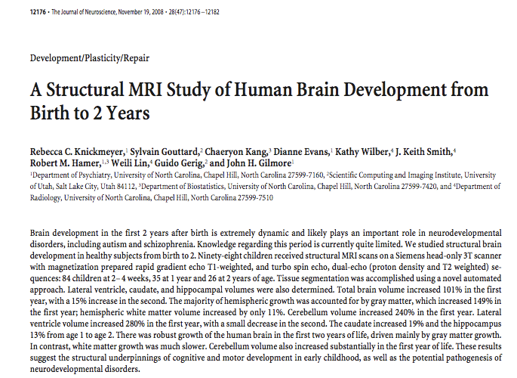

Chiropractic, maximising neural plasticity for all babies.
“Birth to 2 years” is the period in which therapeutic interventions to support plasticity can have the greatest positive effect.
Journal of Neuroscience

Slide 10
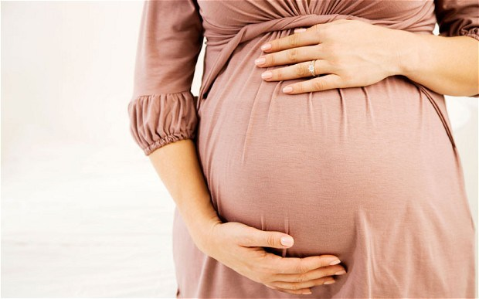

Slide 11

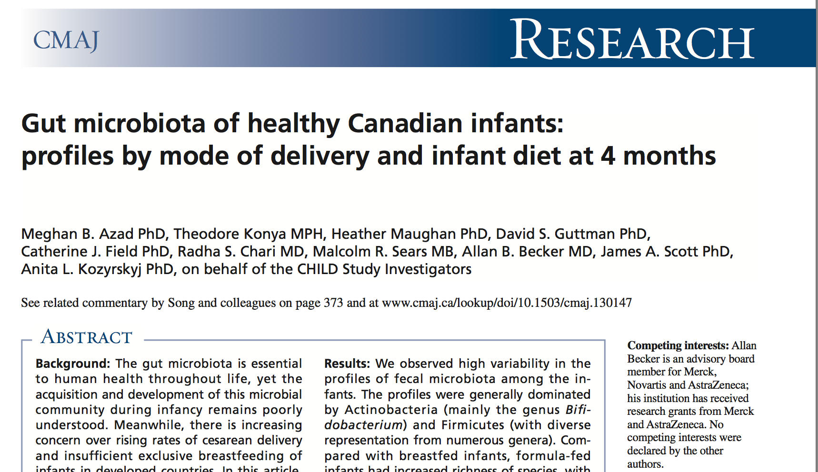
Non allergenic
Stable immune responses
Gut Strength
Type 2
T1
Allergenic
Heightened immune
responses
No gut strength
Derails GBI axis
Type 2
T2
The Canadian Medical Association Journal stated
“the mode of delivery and lack of breastfeeding disrupt “gut balance” which has been linked to an increasing number of diseases, including inflammatory bowel disease, diabetes, obesity, cancer, allergies and asthma.”
CMAJ, March 19. 2013, 185(5)

Slide 12
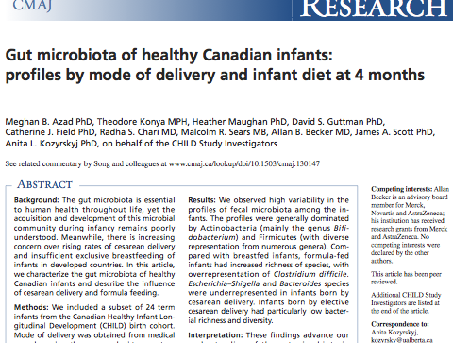
“babies born via CS predisposed to allergies”
CMAJ February 11, 2013
No activation of the respiratory centres.
No expulsion of the contents of the lungs.
No exposure to essential bacteria.

Slide 13
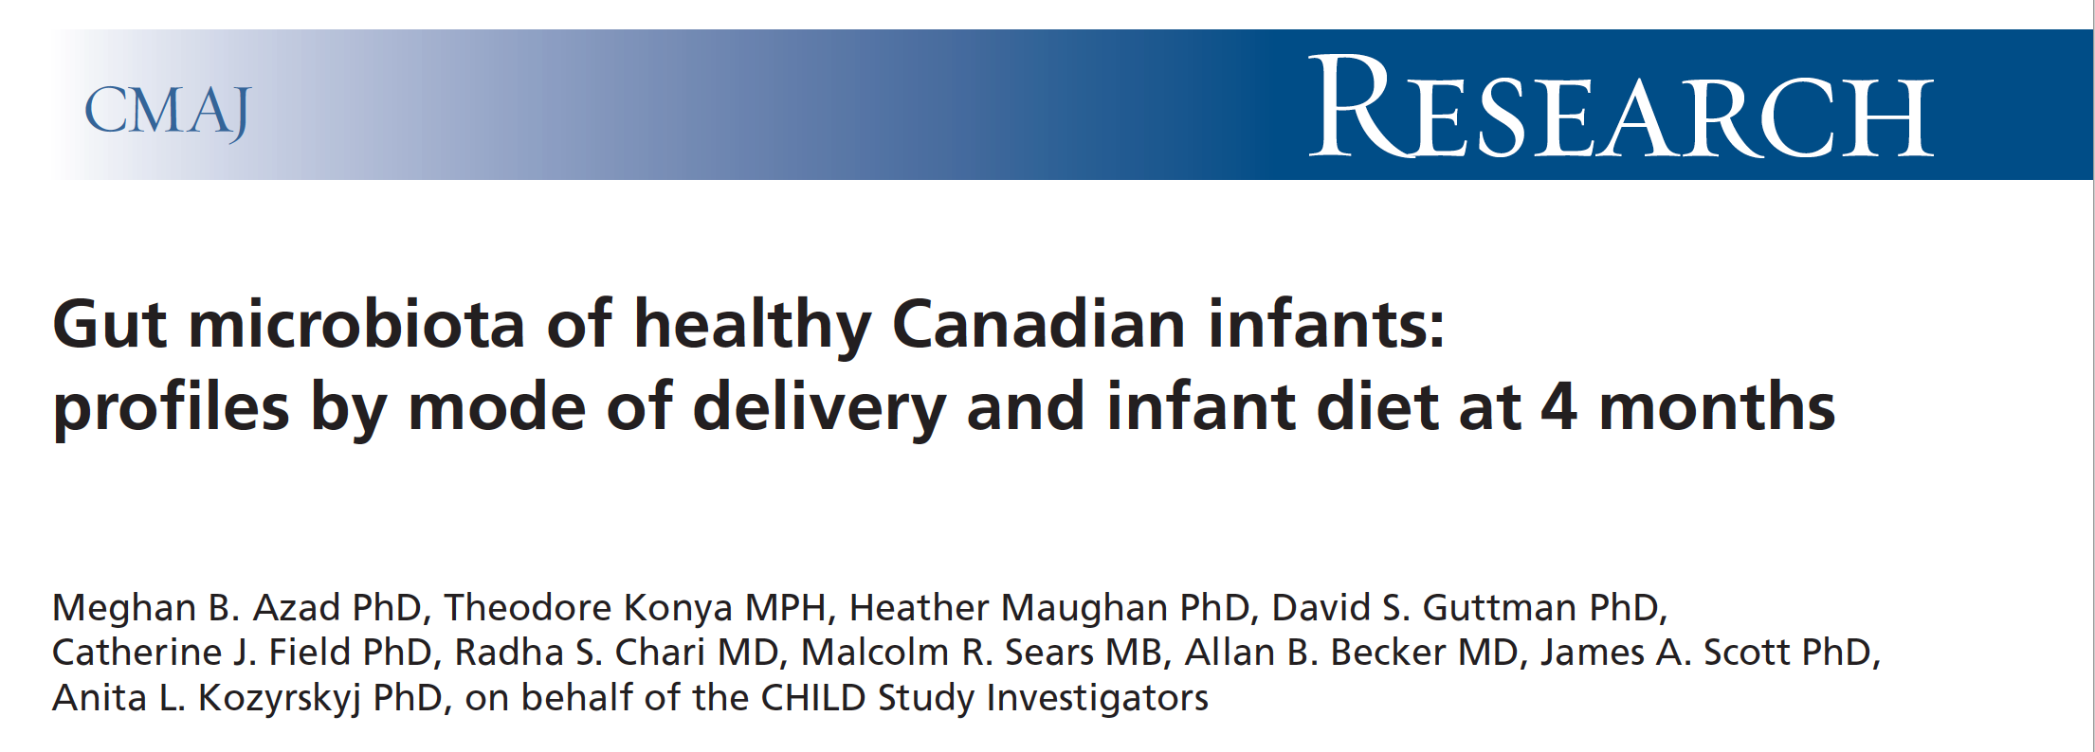
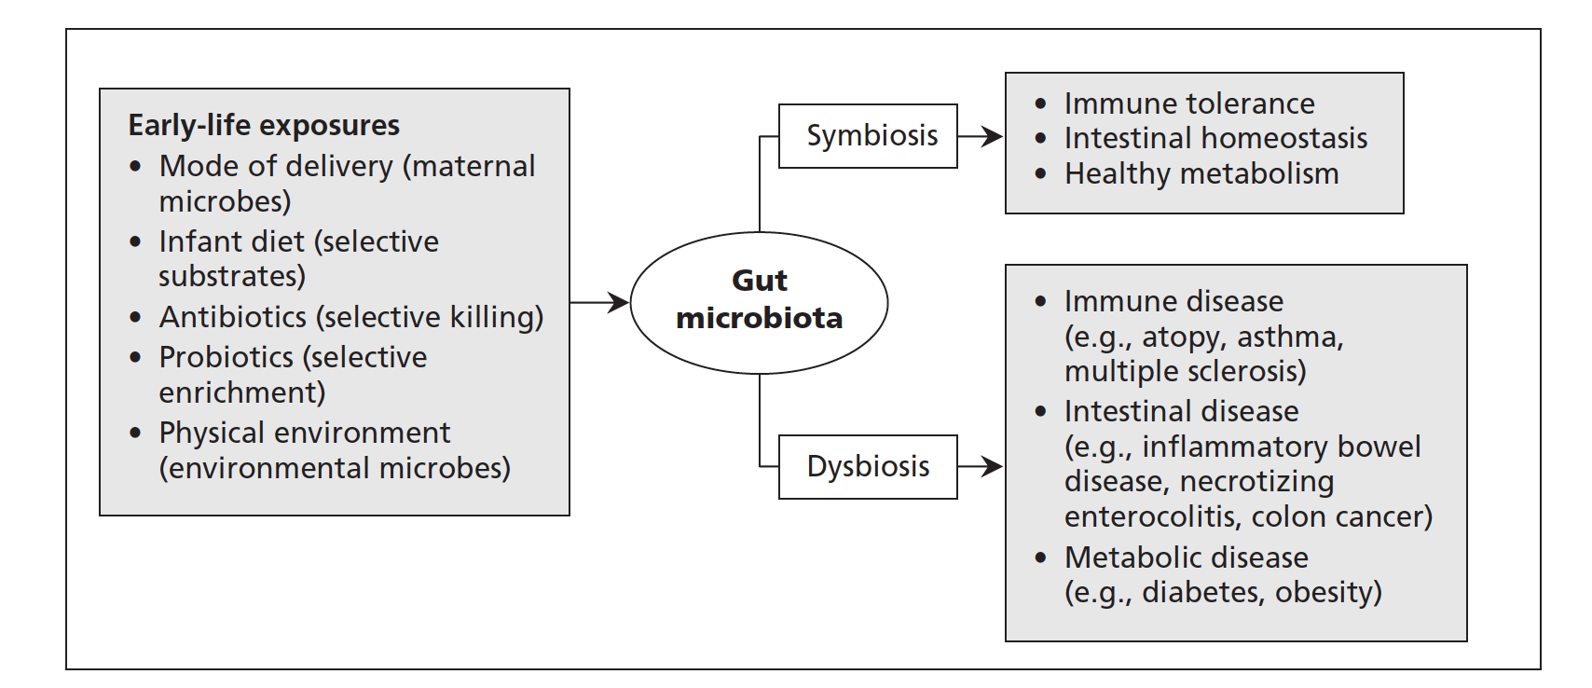

Slide 14
Dystocia
Main Causes for Dystocia. Williams Obstetrics Text. 3rd Ed.
1 – Insufficient or Ineffective Contractions
2 – Abnormalities with alignment, anomalies of pelvis
3 - Abnormalities of presentation, position or development of the fetus
Subluxation is a major cause of Dystocia.
Dystocia is a major cause of Subluxation.

Slide 15
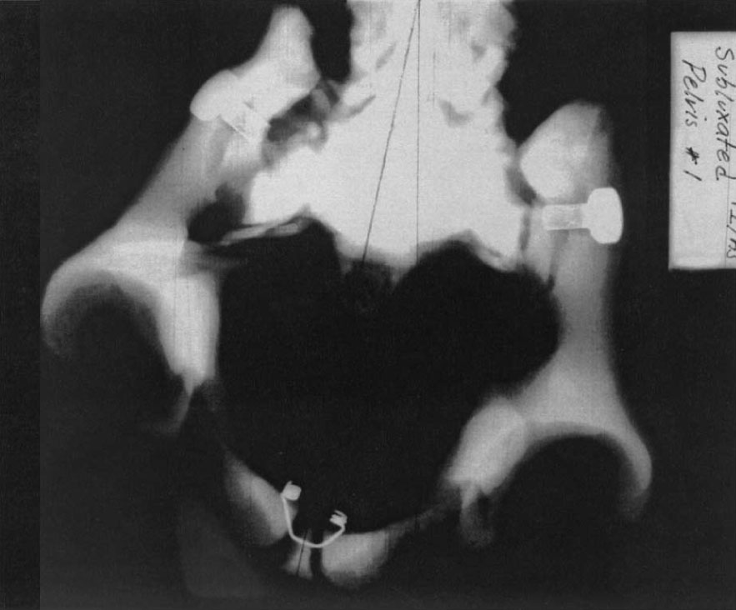
PI/AS subluxation
PI/AS subluxated female pelvic bowl. S to I view.
Note lack of symmetry and distortion of roundness of opening and the difference in space from centerline through pubic symphysis.
Notes:
Jen
(Radiograph provided courtesy of Cherie Goble, DC.)
Richard A. Pistolese, DC THE WEBSTER TECHNIQUE: A CHIROPRACTIC TECHNIQUE
WITH OBSTETRIC IMPLICATIONS Journal of Manipulative and Physiological Therapeutics July/August 2002

Slide 16
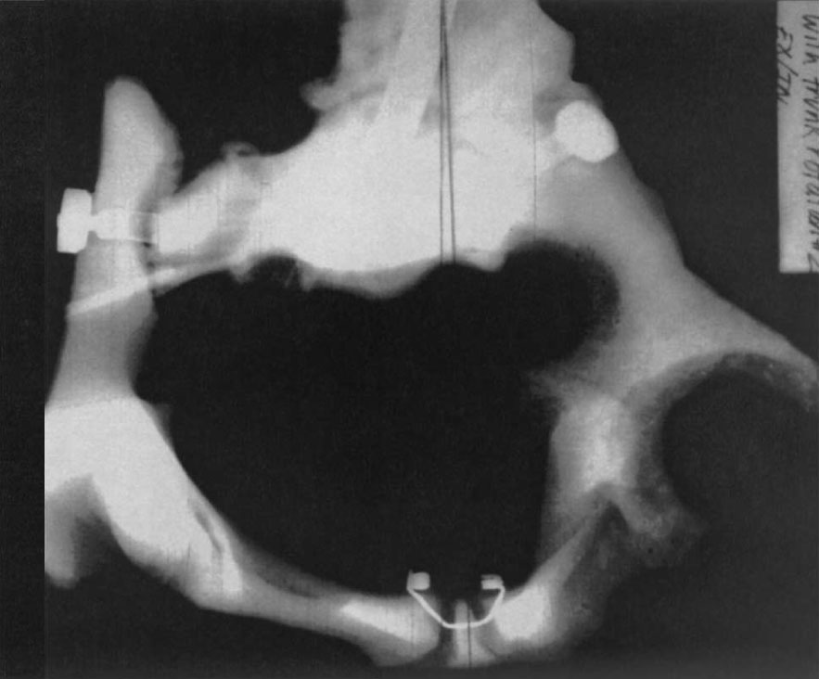
Ex/In subluxation
Ex/In subluxated female pelvic bowl. S to I view. Note lack of symmetry and distortion of opening and difference in space from centerline through pubic symphysis to right ilium.
Notes:
Jen
(Radiograph provided courtesy of Cherie Goble, DC.)
Richard A. Pistolese, DC THE WEBSTER TECHNIQUE: A CHIROPRACTIC TECHNIQUE
WITH OBSTETRIC IMPLICATIONS Journal of Manipulative and Physiological Therapeutics July/August 2002

Slide 17
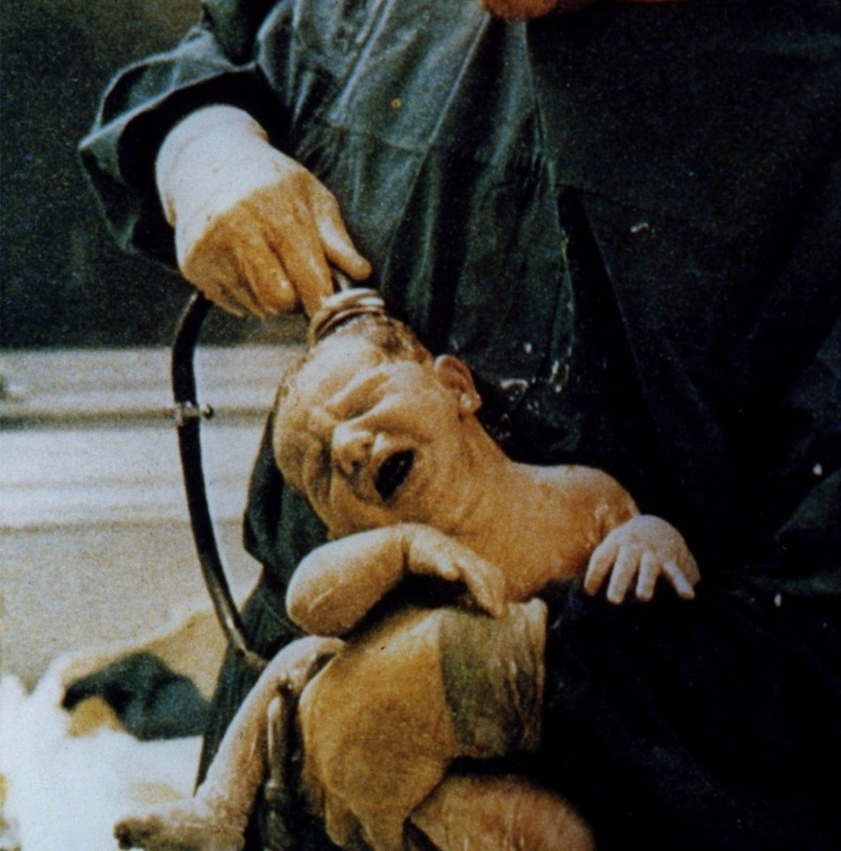
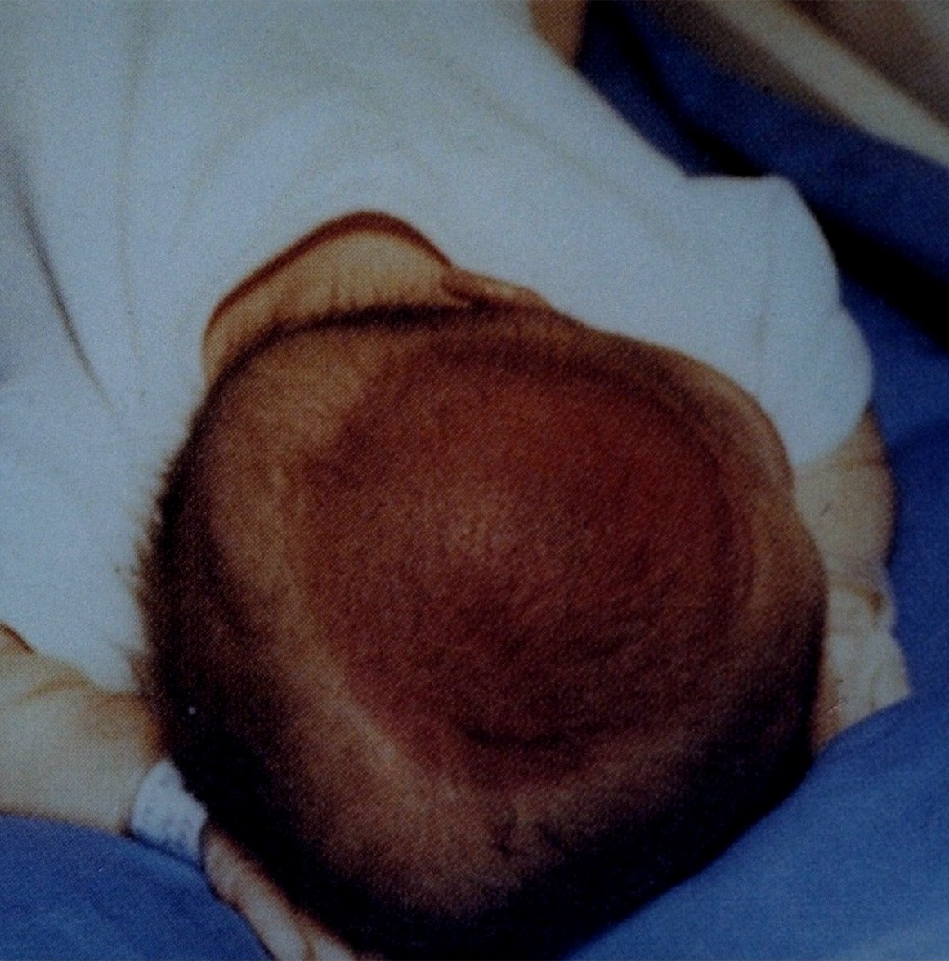
Notes:
Research has shown that vacuum extraction is preferable to forceps in almost all cases, as it causes less trauma to mother and baby.
The decision to choose forceps or vacuum will often depend on your caregiver’s preference and training rather than scientific evidence.

Slide 18
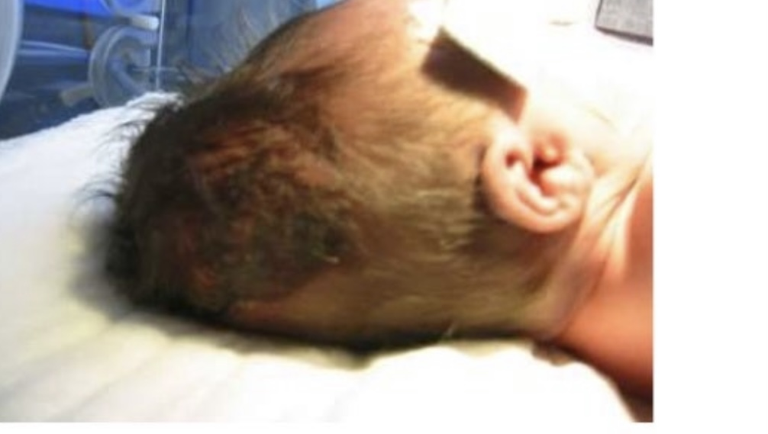
Notes:
Research suggests that ventouse is preferable

Slide 19
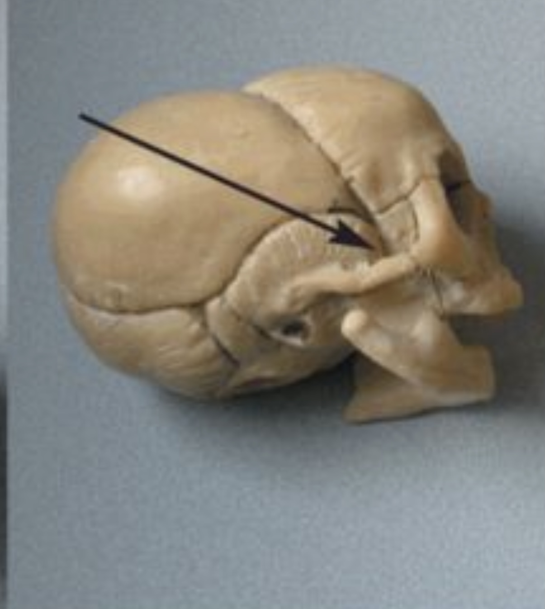
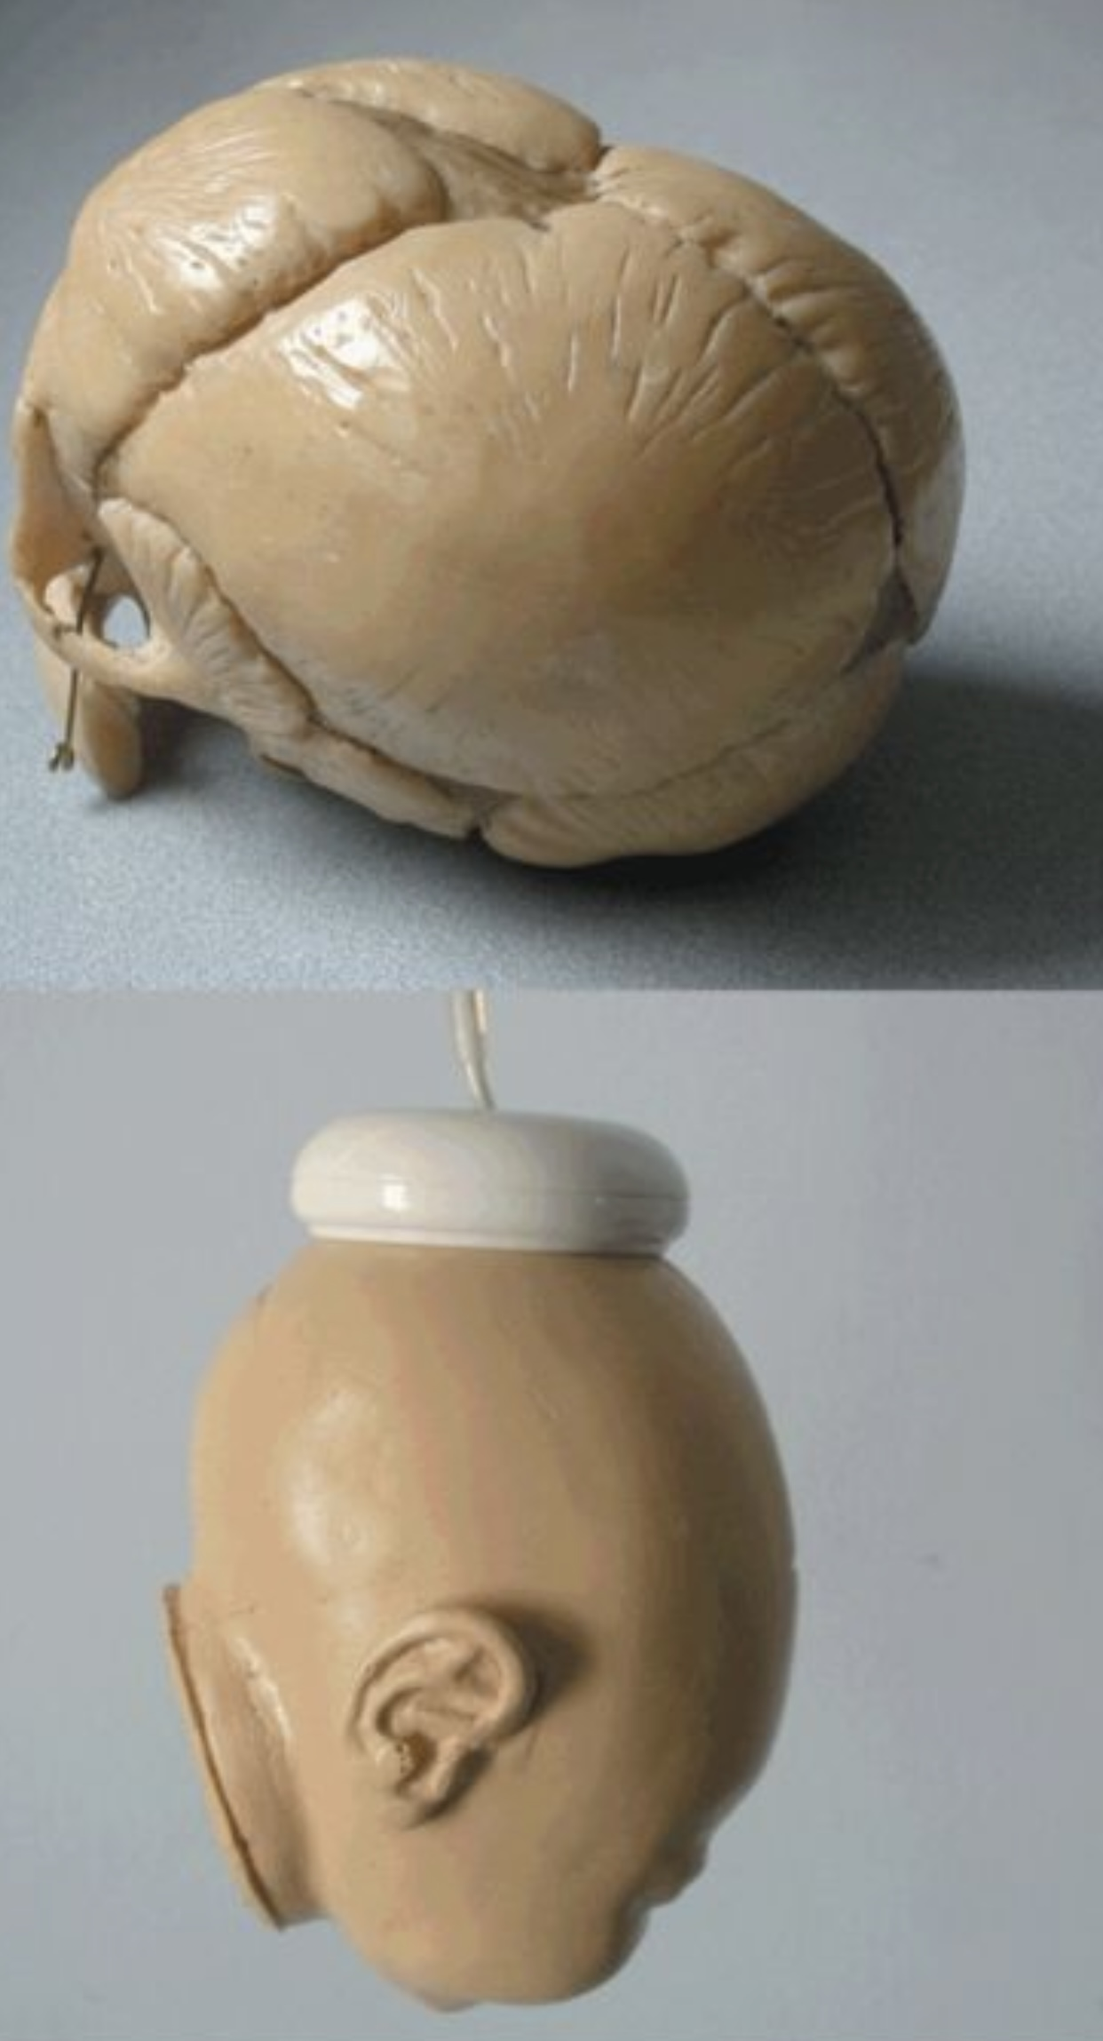

Slide 20
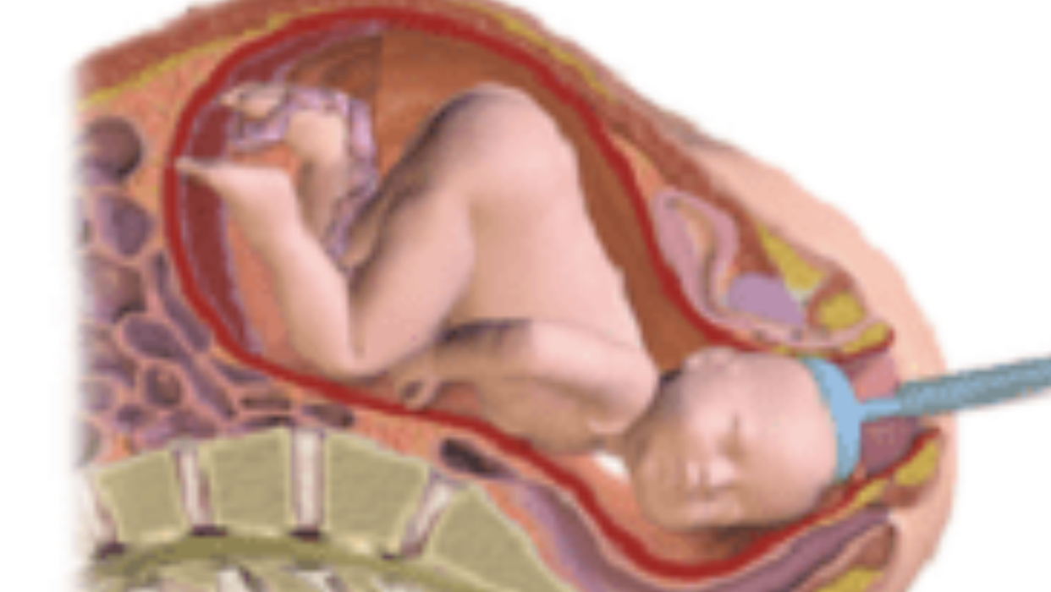

Slide 21
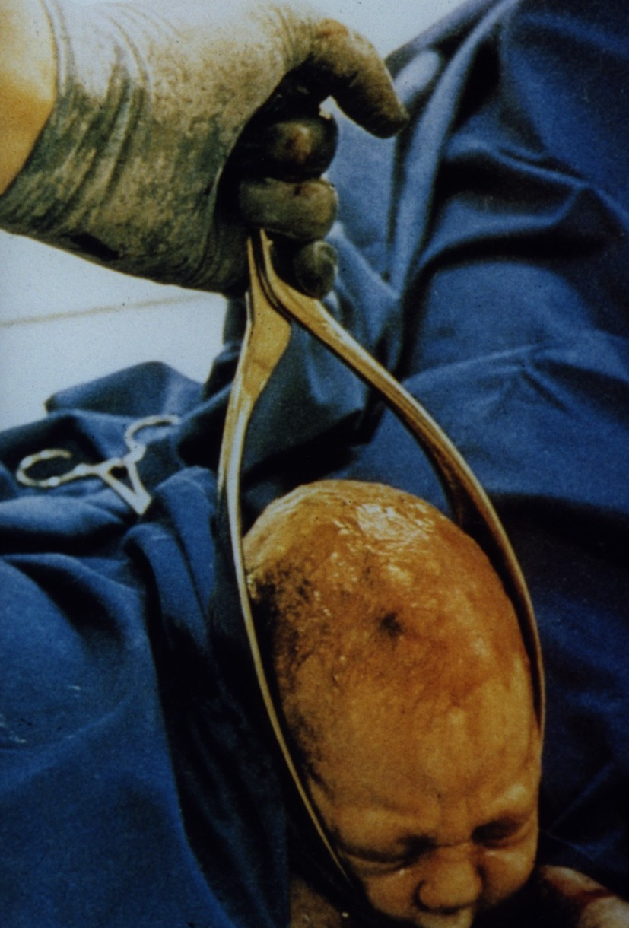
Studies indicate that ventouse is safer for babies than forceps.
Notes:
Better than this

Slide 22
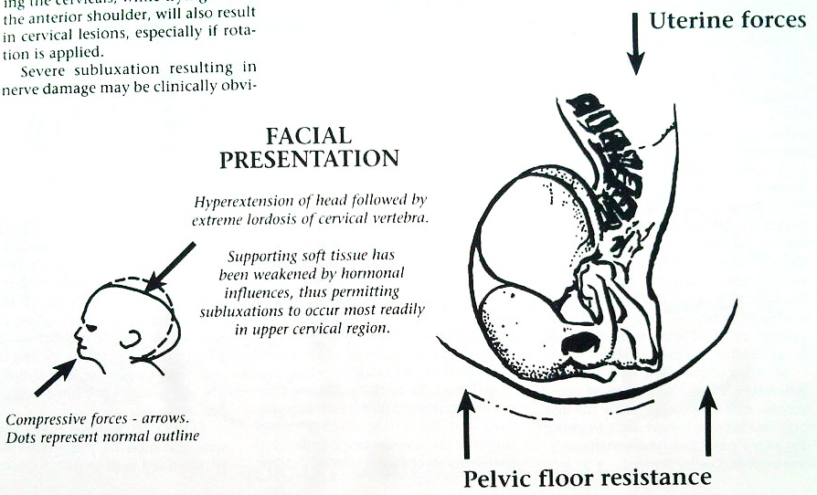
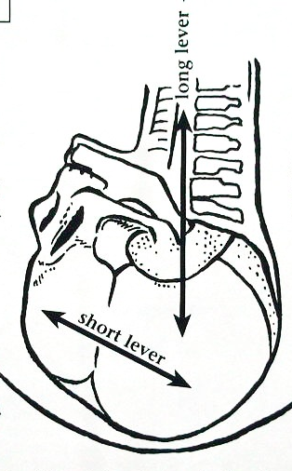
Birth trauma is a major cause of breastfeeding issues - even with babies born vaginally.
Unfortunately, many mothers give up breastfeeding due to the infant’s inability to nurse properly.
Notes:
Imagine if more mothers realised that their inability to BF – was not about them being a bad mother – as they might think – more that their baby when having to turn their head, suckle and move their cranials, and jaw was in PAIN

Slide 23
Studies show that 83 % mothers had at least one drug dispensed in the course of study period ,
(including the three months before and after pregnancy).
Cohort study of 106,000 pregnancies in Norway.
British Journal of Clinical Pharmacology 2008

Slide 24
The European Respiratory Journal 2001;18:598-611.
The world's largest asthma study supports the link between paracetamol use and an increased susceptibility to asthma. This study was carried out in over 22 countries and involved over 140,000 participants. The researchers reported that asthma and allergy-related symptoms were most prevalent in countries with the highest doses of paracetamol intake.

Slide 25
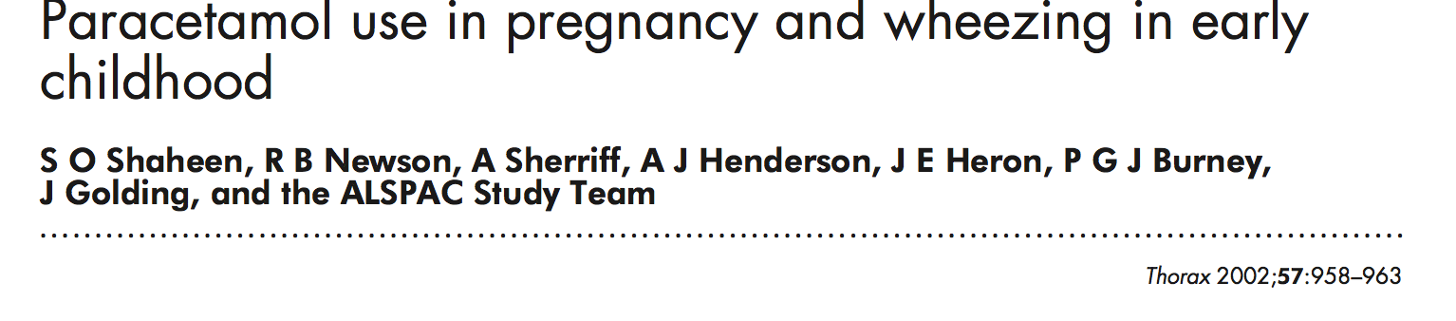
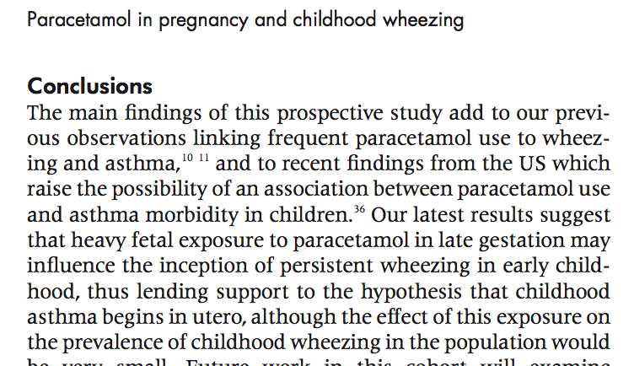
Over 90% of 468 drugs approved
by FDA in relation to birth defects have
undetermined safety
in pregnancy
(Lo and Friedman,
Obst & Gyn 2002)
Short and Long Impact
Glutathione
Critical for our unborn, adults and infants alike
Fuel for the brain (80%)
Increase Oxidative stress and
Inflammation
Notes:
The problem is Over 90% of 468 drugs approved by FDA in relation to birth defects have undetermined safety in pregnancy
SO when a pregnant mother experiences a headache or back pain and 2/3rds of all pregnant women get back pain - why bec, of the use physiological changes that occur in pregnancy - increase in hormones that create hormone and joint laxity - so its a time where the weakest link - is put under more stress then ever before.
and so when she takes paracetamol as this is WHAT SHE KNOWS HOW TO DO this has a short term and long term impact on her unborn baby
This paper talks about the long term impact being wheezing and asthma
but the short term impact is that analgesic drugs taken during pregnancy (and analgesics - pain relieving drugs in childhood - tynelol cold and flu syrups)
and I want to bring this up here bec. we have an epidemic of glutathione defic not just in children but across the board …the body needs certain vitamins and minerals to detoxify and get toxins out of the body…certain lifestyle choices deplete those vitamins and minerals that are needed
we also need glutathione MOTHER OF ALL Anti Oxidants (fight the bad guys in the body) and plays a primary role in the protection of all cells from daily metabolic stress, and toxic chemicals.
Analagesics …..Deplete the body of Glutathione is the body’s most powerful antioxidant
^{Mistro of the immune system}
Critical role in detoxification
Gluthione as an antioxidant is sticky and takes toxins out of the body when we have a depletion of glutathione we get a build of of toxins……… and more inflammation and oxidative stress (out of balance) in the body ….too many bad guys who then start causing cell damage …more inflammation and disease
leaves us vulnerable to oxidative stress keystone to many disorders associated with inflammation, leading to allergies and chronic disease.
One of the most important things to understand about the development of the brain ALSO relies 100% on glutathione to support development.
As glutathione levels decrease, so does the “fuel” needed for development.
SO Glutathione helps to grow, develop and protect the brain as well through a process called methylation. And it regulates detoxification. Without glutathione the brain and NS are potentially undeveloped and unprotected to higher levels of toxins in the body
Methylation and detoxification form an important balance that supports development.
AND WHEN they deplete glutathion…more inflammation in the body…..
N-Acetyl-Cysteine (NAC) is an endogenous form of cysteine, and the most bio-available precursor to glutathione peroxidase (essential for glutathione synthesis). Glutathione is involved in detoxification, binding to toxins (heavy metals, solvents, and pesticides) and transforming them into a form that can be excreted by the body via urine or bile.

Slide 26
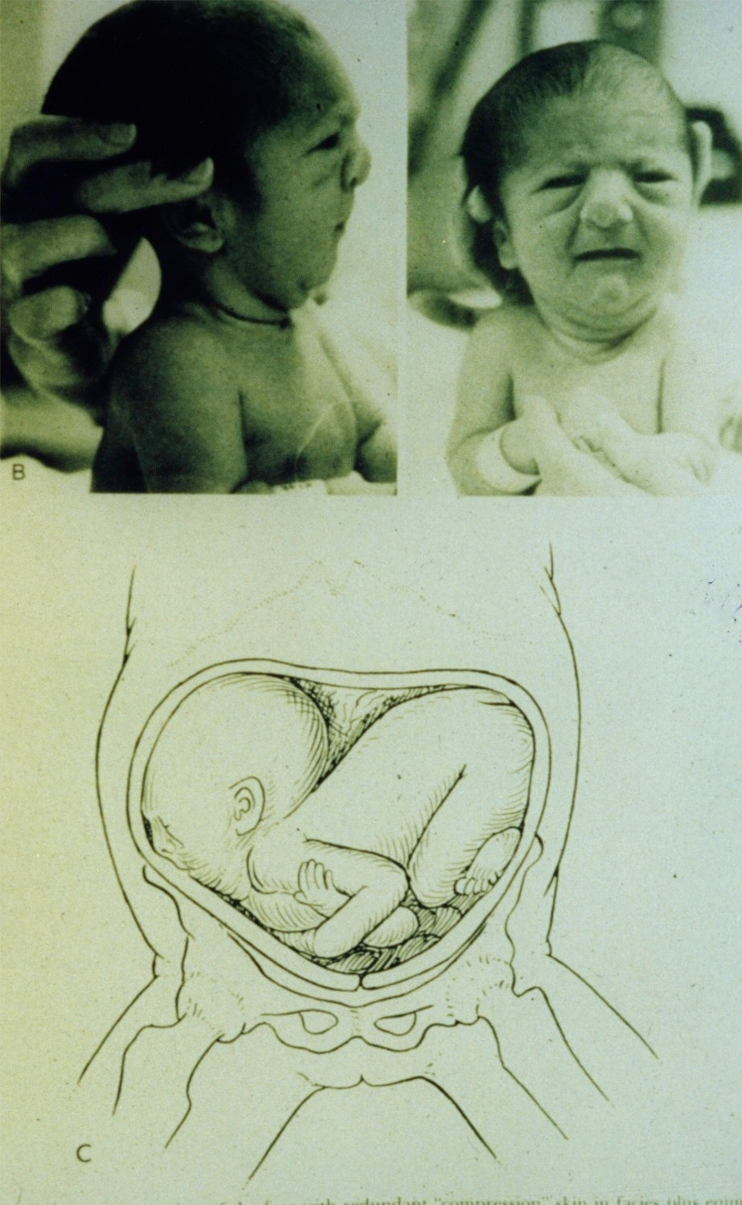
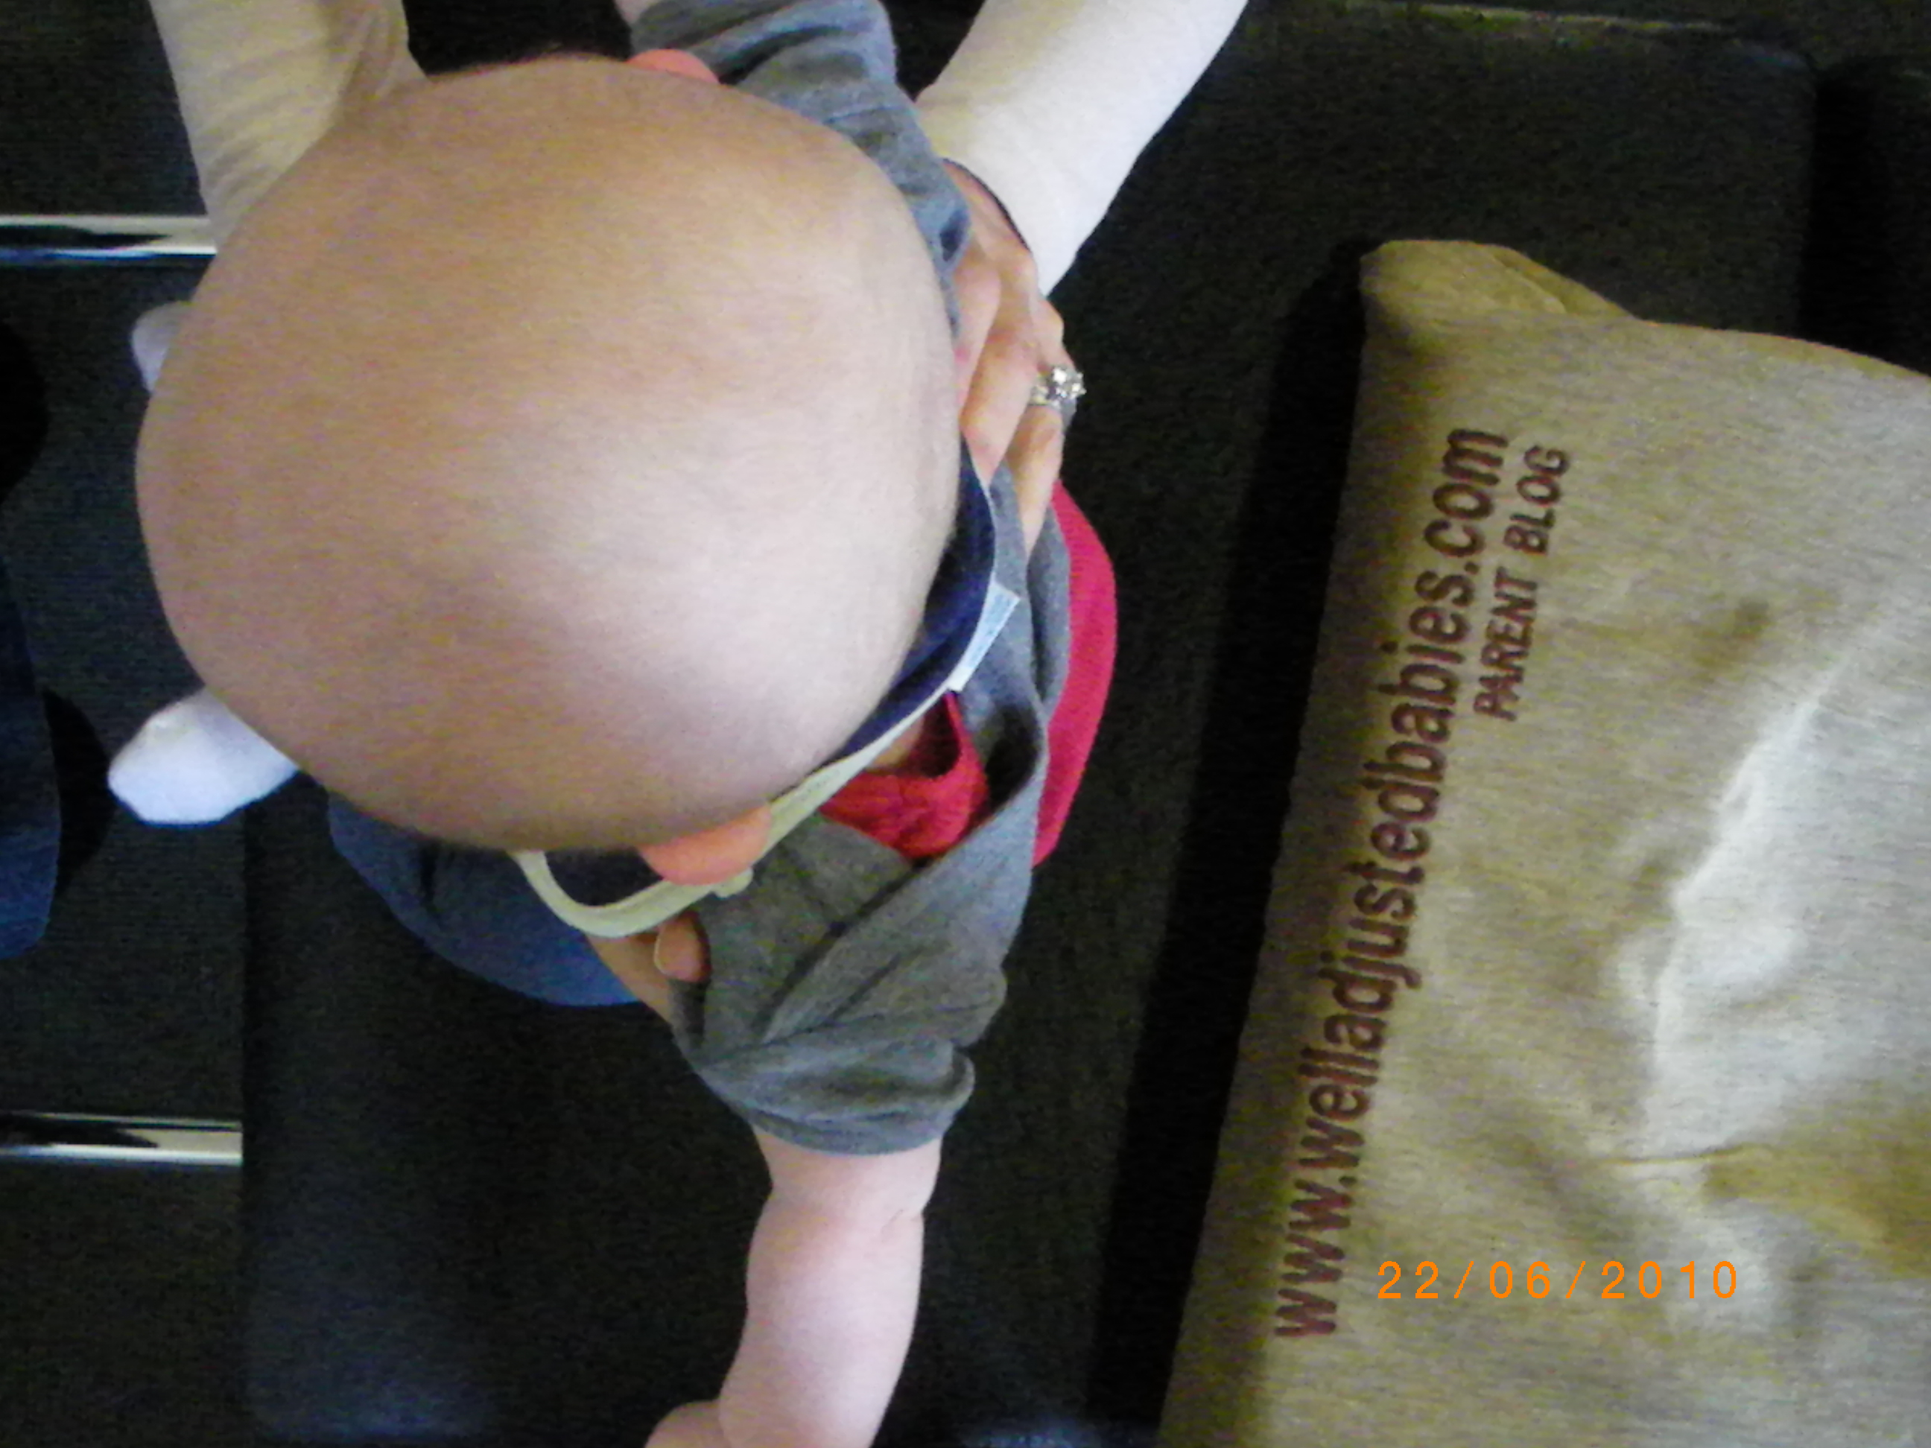
Developmental Delay, Sensory Processing Delay, Phagiocephaly, Autism have been linked with breech positioning.
Chiropractic helps babies thrive developmentally in the womb.
Activating
primitive reflexes
and the
development of
the vestibular system

Slide 27
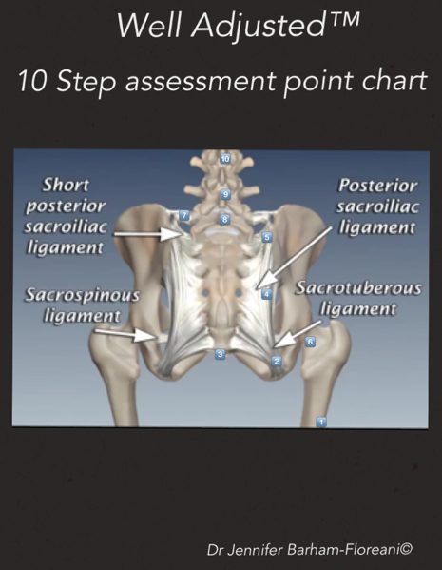
Assessing Posterior
1. Leg Length
2. Sacro-tuberous ligament
3. Coccyx
4. Sacrum
5. Superior SI Joint
6. Gleno-femoral head
7. Ilio-lumbar Ligament
8. L5
9. L4
10. L3, L2, L1
Notes:
We developed over a number of years

Slide 28
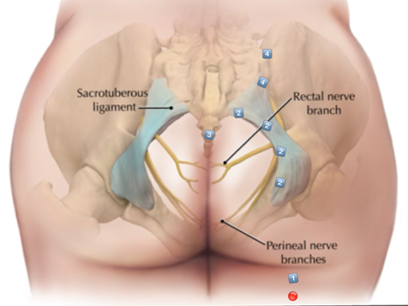
Proximal
Whole length

Slide 29
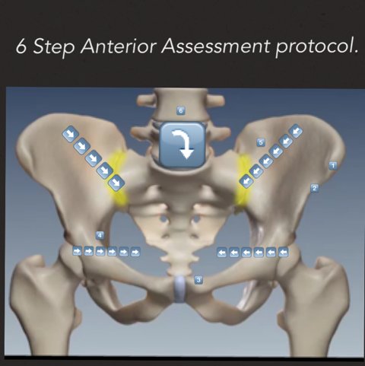
1. ASIS
2. AIIS
3. Pubis
4. Psoas and Round Ligament
5. Lower Quadrants
6. Upper Quadrant
Notes:
1. ASIS
2. AIIS
I check ASIS and AIIS to ascertain SI or Pubic involvement - here is an ASIS prominent then SI – primary
3. Pubis
I check the pubis itself - Typically supr and ant’r on side opposite to postr rotn of sacrum)
4. Psoas and Round Lgmt –
Check psoas if there is torsion in the pelvis
Round lgmt – pain into groin on rising
Round lgmt tension often when constraint in uterus – with Breech pres - Often tender on side opposite to sacral rotation
Contact · Draw an imaginary line from the umbilicus 45 degrees inferior and lateral.
· Draw another imaginary line 45-degree from the ASIS inferior and medial lower quadrant.
· The intersection of these two lines is the initial place of contact.

Slide 30
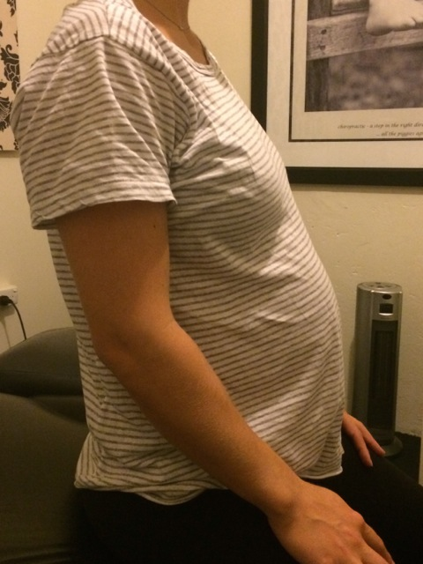
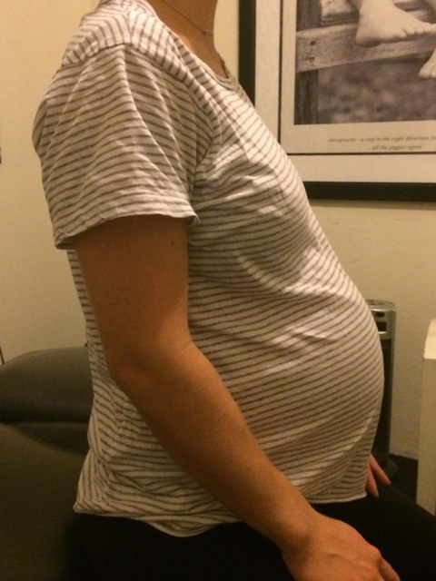
Pictures of a mum with constraint
Notes:
Flattening, push through
upper abdomen

Slide 31
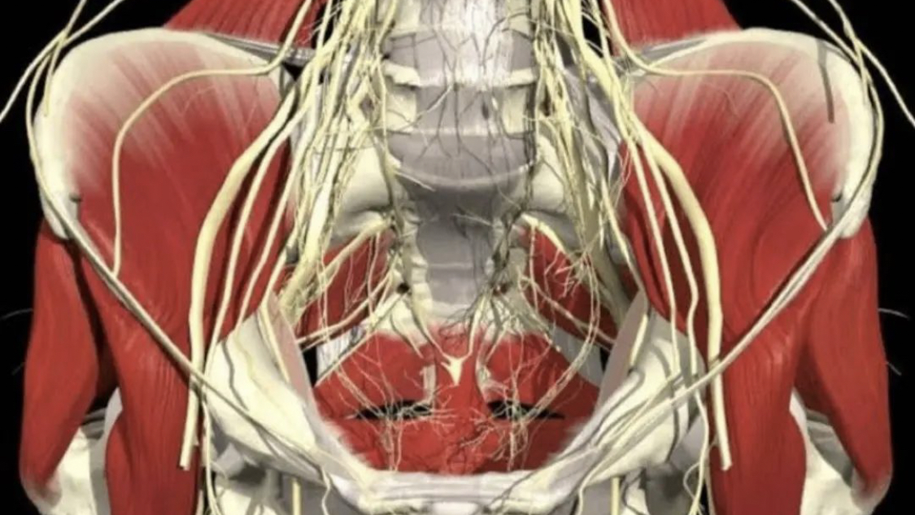

Slide 32

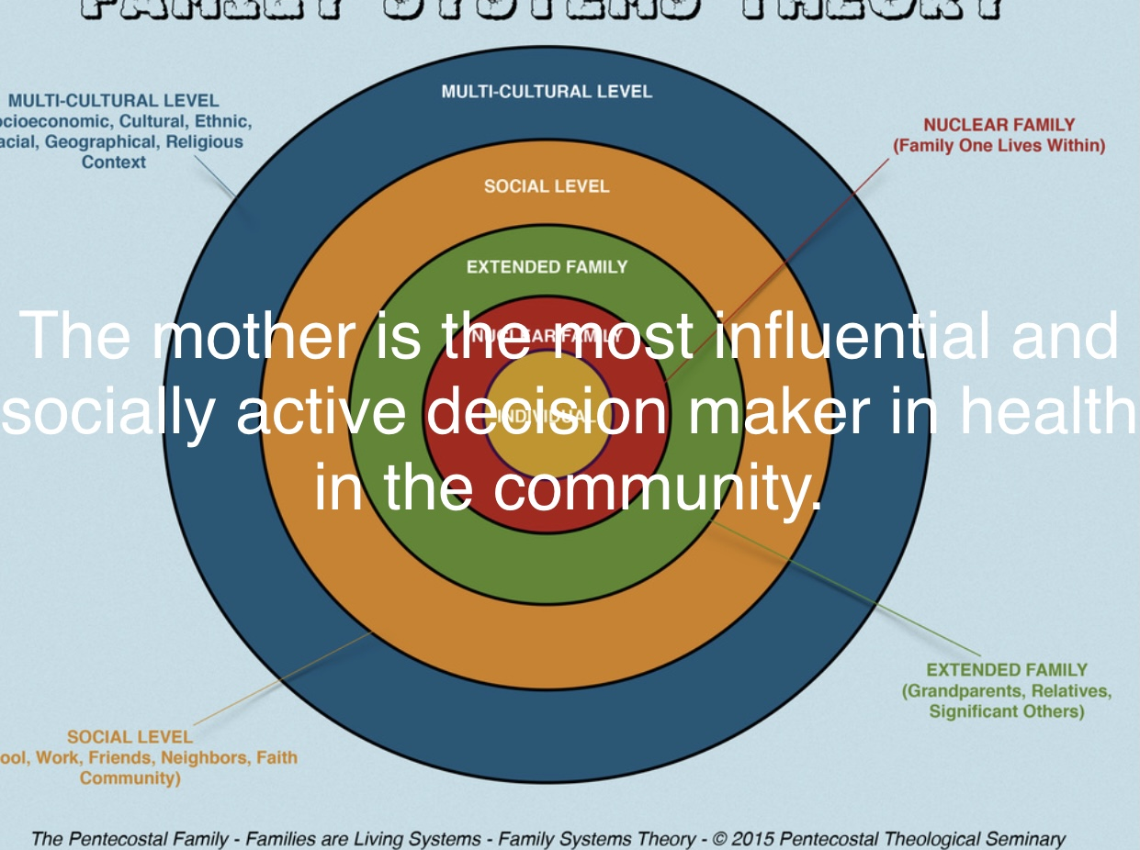
Rule of 15.

Slide 33


Encourage them to
Ask Good Questions

